Slide 1
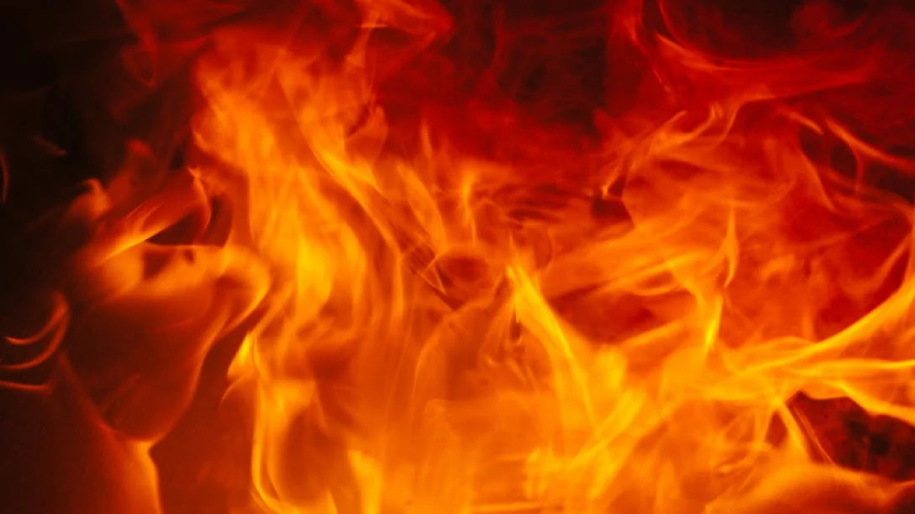


Fireballs & Bolides
Kameron Thao Leah Nash Nou Yang
Valerie Grannemann-Barber

Slide 2
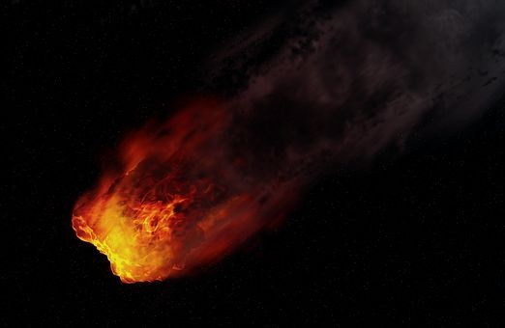
What is a Fireball?
The visible part of a meteoroid/ shooting star that has entered the Earth’s atmosphere
Fireballs are e ceptionally bright, but usually only visible at night
Fireballs reach a visible magnitude of -3 or brighter
Exploding ﬁreballs are called bolides

Slide 3
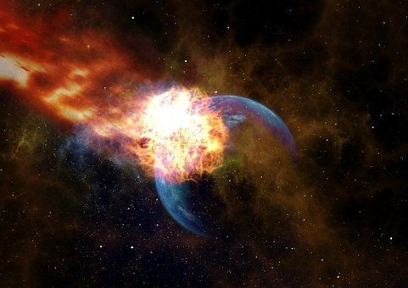
The Data
Source: Fireballs (cneos.nasa.gov)
Fireball event sightings captured by US Government sensors and ground observers
Documentation dates as far as 1988
Currently over 900 records
Data components:
Date/ Time
Latitude / Longitude
Altitude
Velocity
Total Radiated Energy
Calculated Total Impact Energy

Slide 4

The Process
Data Cleaning
Converted data types
Extracted data
Insert new columns
Database: SQLite
Track: A dashboard with views and interactive visualizations
JS Library:

Slide 5

Research Questions
?Trends by location
? Correlation between peak brightness and velocity
?Trends by year 4. ?

Slide 6

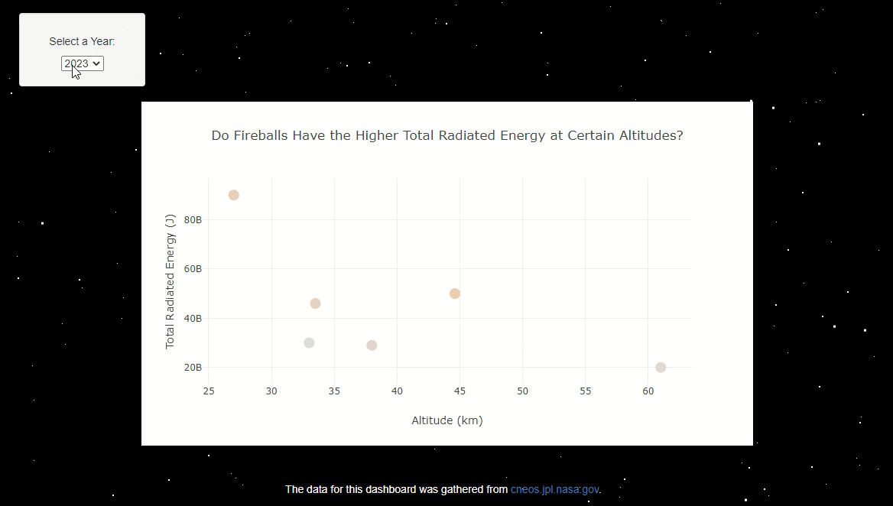
Is there a correlation between a fireball’s total radiated energy in the atmosphere and the altitude at which it is observed?
Total Radiated Energy values ranged from to 20 Billion 3.75 Trillion Joules
Altitude values ranged from 14 to 74 kilometers
Fireball with Highest Total Radiated Energy (3.75 T Joules) at 23.3 km Altitude
Notes:
Nou

Slide 7
Question 2

Slide 8
Question 3

Slide 9


Slide 10

Conclusions
Fireballs more commonly have higher total radiated energy at altitudes above 20 kilometers and below 50 kilometers.

Slide 11
Thank You!

